Slide 1
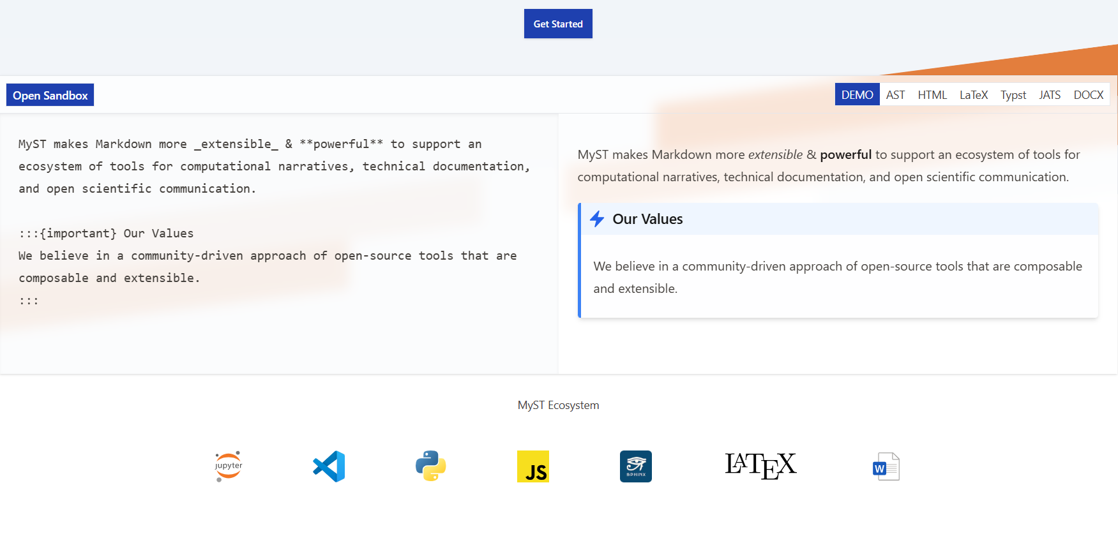
MyST & Jupyter Book 2 Community-driven tools for technical communication
Name…
Email…

Slide 2
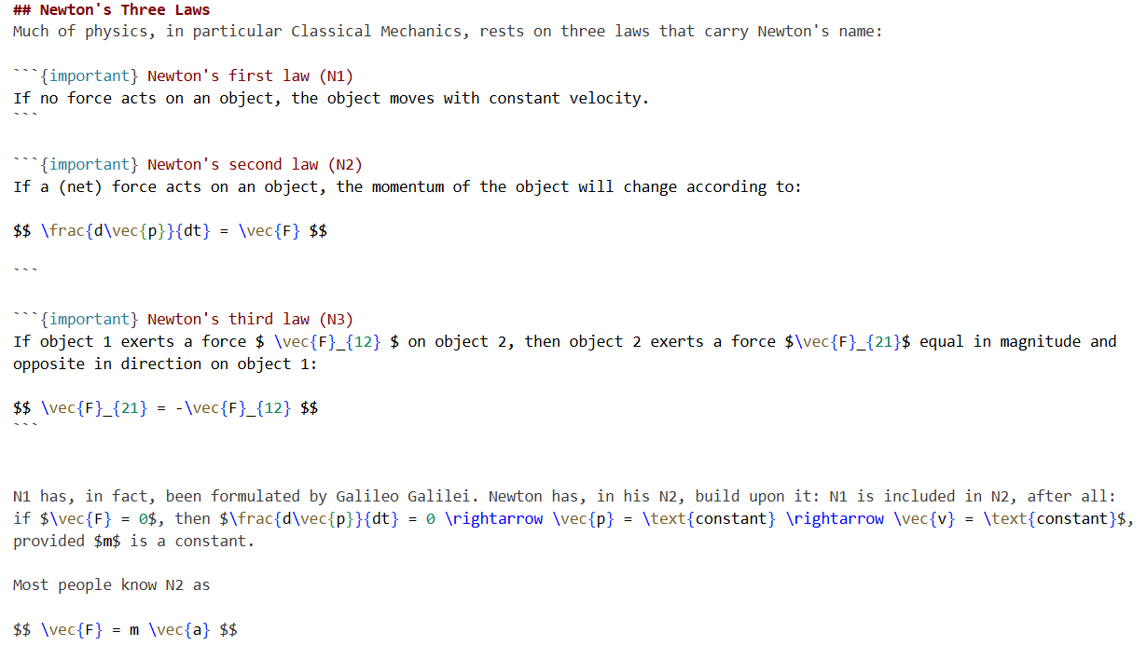
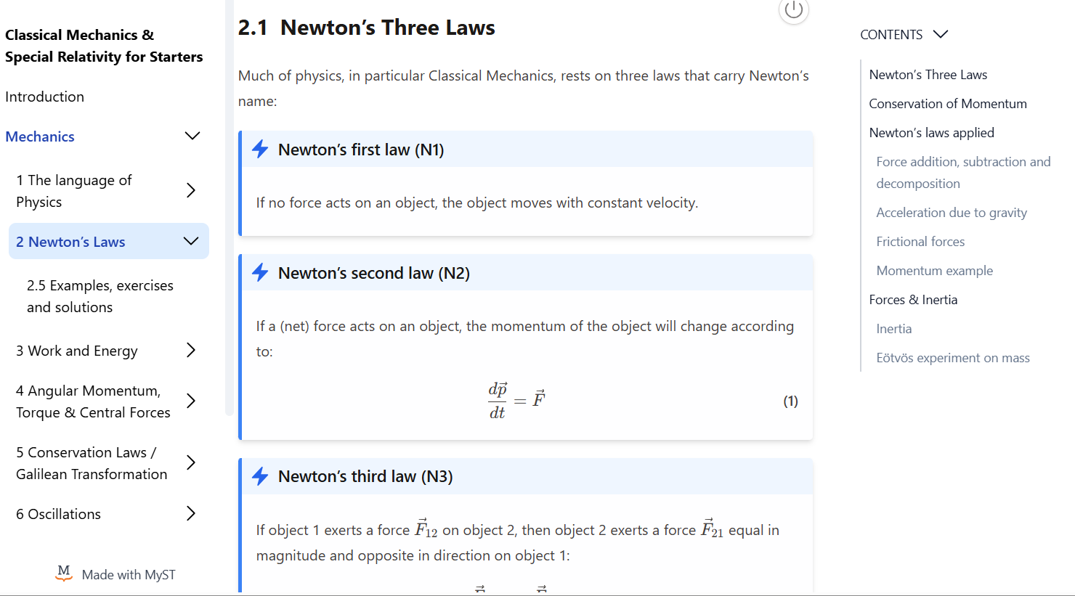
Jupyter Book project
The Jupyter Book project^{[1]} builds tools for authoring, reading, and publishing computational narratives.

Slide 3
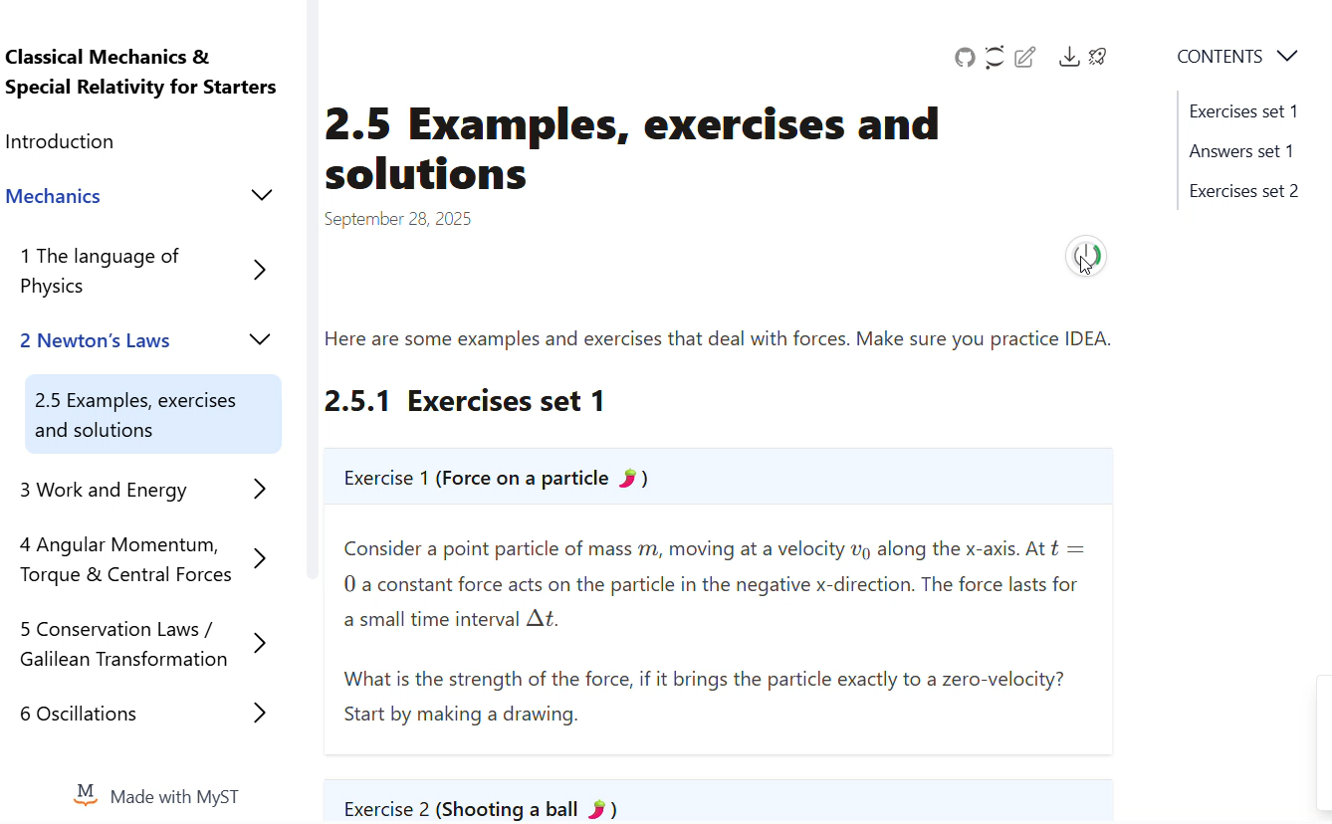
Jupyter Book project
Jupyter Book lets you create enriched and interactive multi-document computational narratives.

Slide 4
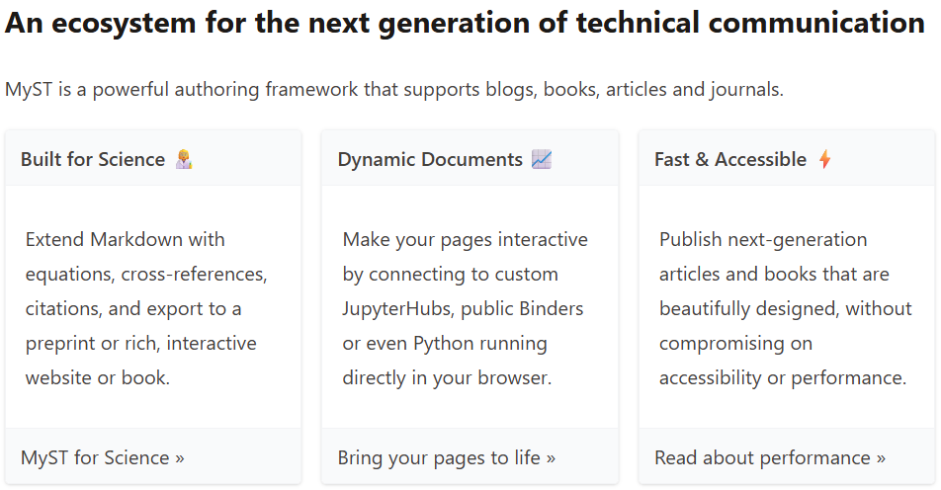
MyST
MyST extends Markdown for technical, scientific communication and publication.

Slide 5
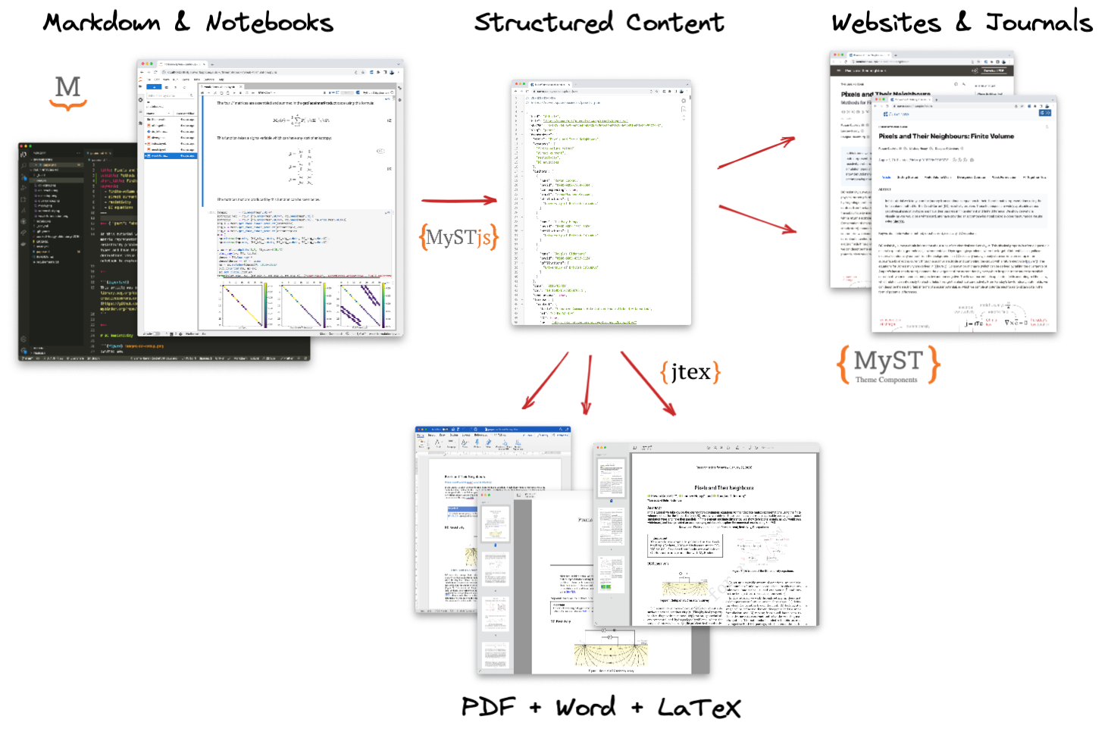
The power of MyST

Slide 6
Gallery

Slide 7
github account
clone template
set up
GH pages
follow (steps from) tutorial
tutorial
advanced
start
install software
jupyter-book init
init local server
see official docs

Slide 8
Where to start?
https://teachbooks.io/
Join the Jupyter Book team at a JupyterHub Collaboration Cafe - Jupyter Book: Blog
c.f.j.pols@tudelft.nl

Slide 9
Acknowledgement
This presentation is based on
the MyST documentation
Chris Holdgraf’s Jupyter Book 2.0 and the MyST Engine presentation
[1]: https://jupyterbook.org/

